Slide 1
SURGICAL ANATOMY & APPROACHES TO BRAINSTEM GLIOMA

Slide 2
Introduction
Brainstem comprises of-
    Midbrain (Mesencephalon),
    Pons and
    Medulla
Highly complex neural structure both anatomically and functionally
Cranial nerve nuclei and numerous fascicles and pathways as well as reticular formation- all playing important roles in securing normal central nervous function and regulation of bodily homeostasis

Slide 3
Historical considerations
Because of its difficult access and functional importance, in the past, the brainstem was seldom explored by neurosurgeons, with its injury often conducive to deep coma
For many years, a tumor growing inside the brainstem was considered malignant in itself and managed empirically as a homogeneous group with radiation therapy as well as adjunctive chemotherapy

Slide 4
Historical considerations
Bailey et al (1939)- ‘BSG are a hopeless problem for treatment’
Dandy (1962)- ‘ There is little indication for attempting any enucleation of the tumour in this region
Baker (1964)- published a series of pts with ‘subependymal gliomas’
Pool(1968)- operated BSG , some of them having a long-term survival

Slide 5
Historical considerations
Gradual advancement in microsurgical technique, sophisticated imaging technology, most importantly availability of MRI
Identification of subcategories of tumours which appear to have low- grade pathologies and offer a better prognosis
Different series on BSG since then

Slide 6
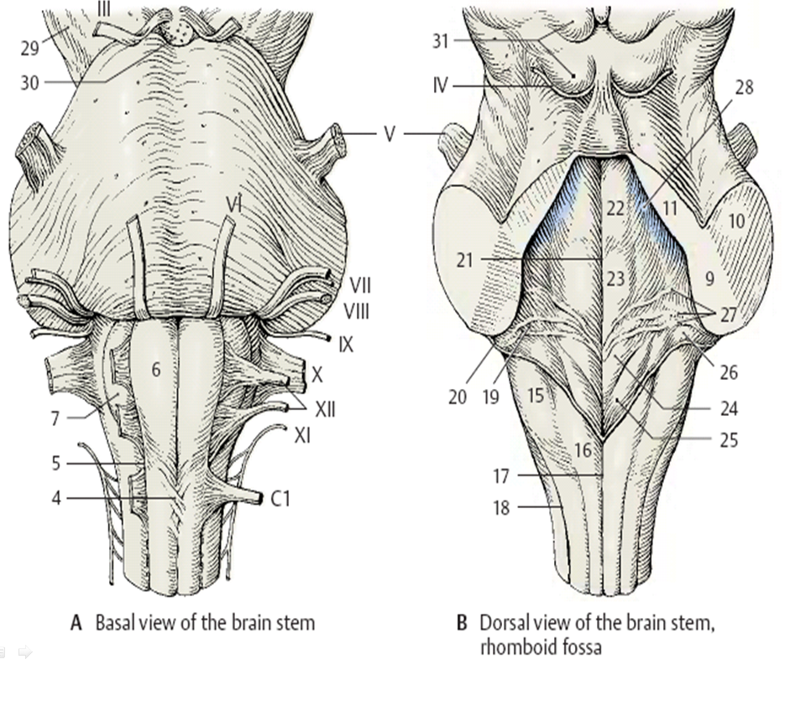
4.bp.blogspot.com

Slide 7
Surgical anatomy - Dorsal aspect
Floor of IV ventricle –
  Rhomboid
  Pons- rostral 2/3rd
  Medulla- caudal 1/3rd

Slide 8
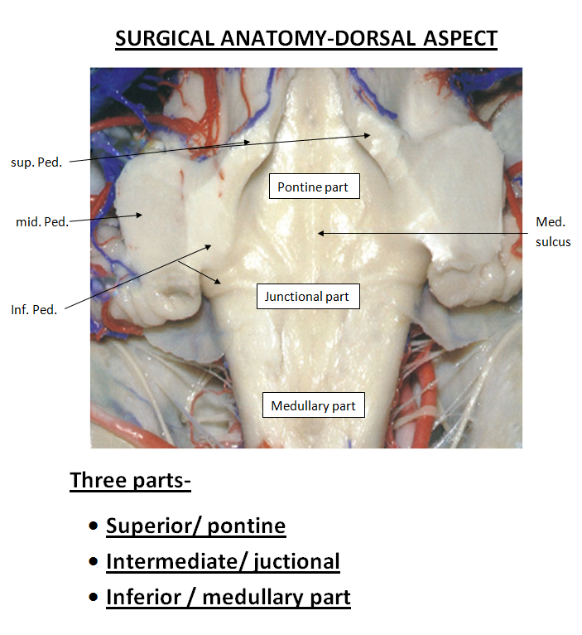
Rhoton

Slide 9
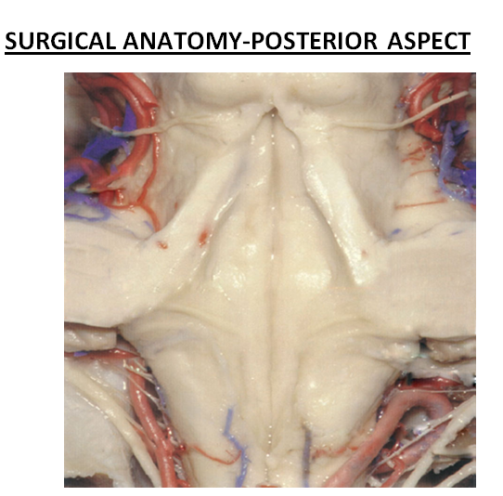
Median sulcus
Sulcus limitans –
  Median eminence(M)
  Vestibular area(L)
Median eminence-
  Facial colliculus
  Hypoglossal triangle
  Vagal triangle
  Area postrema
Striae medullares
Rhoton

Slide 10
Brainstem glioma(BSG)-
Epidemiology
Approx. 1 % of all primary brain tumours, 10-20% of pediatric brain tumours
75% occur in children, 25 % in adults
Median age at presentation-6.5 yrs, adults- 3rd -4th decade
M=F
Approx. 75% diffuse, 25 % focal
Most focal tumours occur in midbrain
Pontine tumours are usually diffuse and high grade

Slide 11
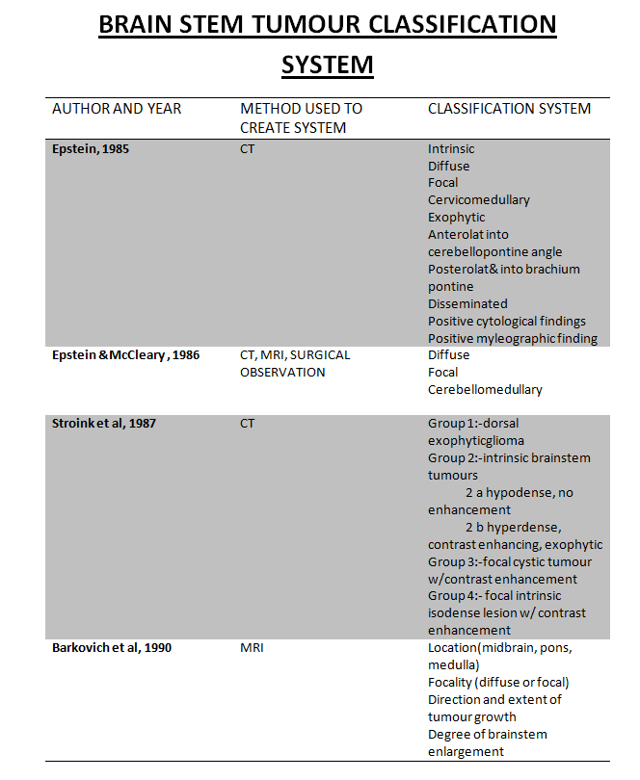

Slide 12
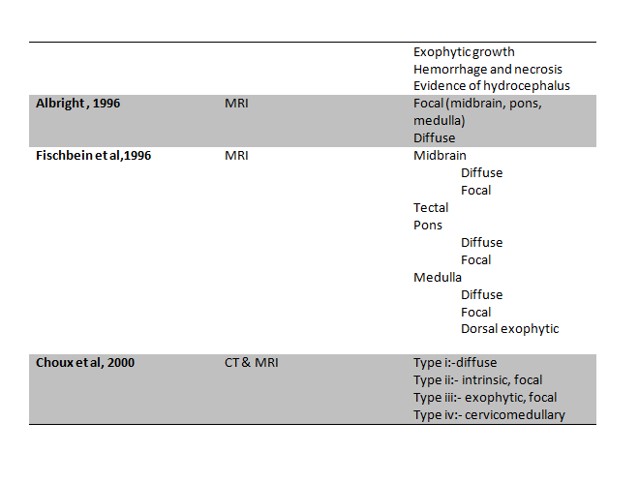

Slide 13
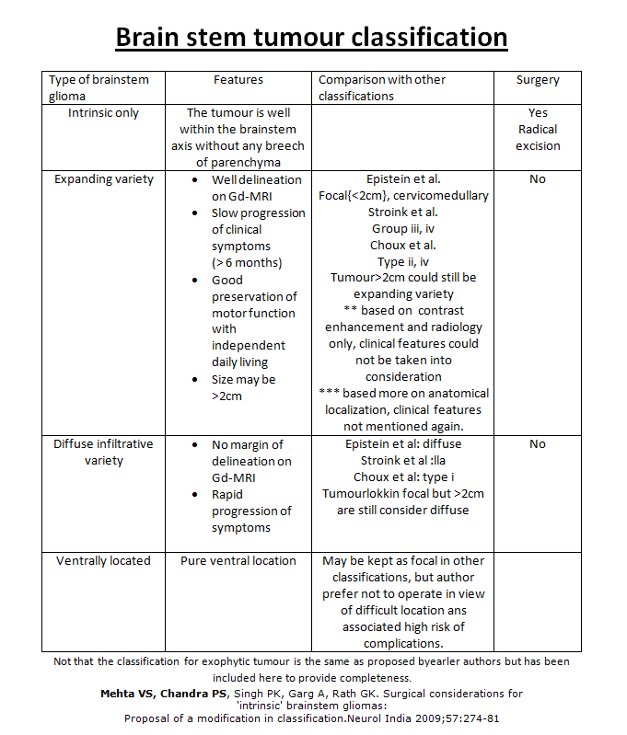

Slide 14
BSG- Pathogenesis
Molecular biology-
    Mutation of p53, a tumour suppressor gene
    Amplification of mutated EGFR gene
    Trisomy 1q, deletion of chr 19
NF – I -
    More indolent course

Slide 15
Imaging
CT-
  Diffuse - hypodense lesion on NCCT that enlarge the pons
  (diffuse pontine hypertrophy) and displace IVth ventricle posteriorly, inhomogenous post-contrast enhancement

Slide 16
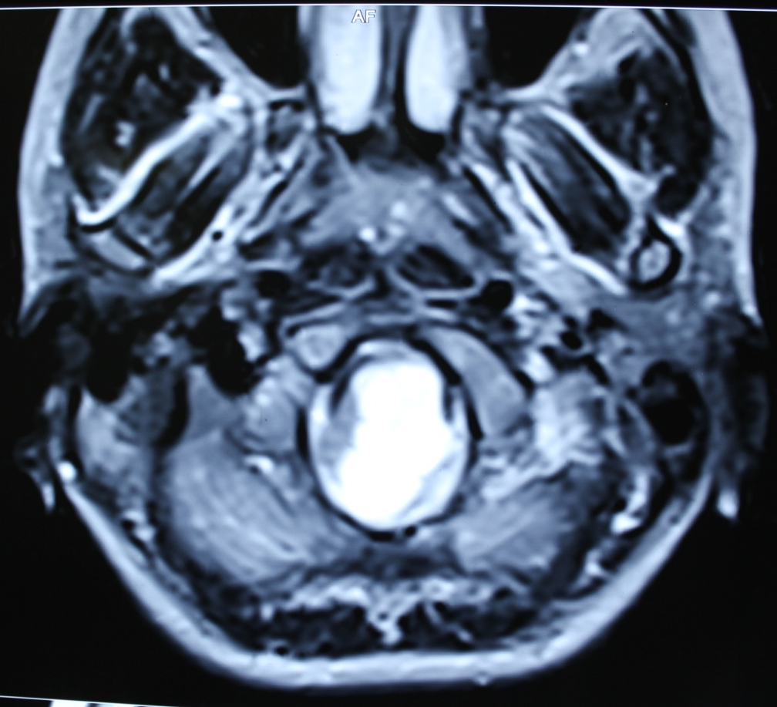
Imaging
CT-
  Focal midbrain tumours( tectal plate glioma) may not be seen on NC + CECT head , leading to a false diagnosis of late onset aqueductal stenosis
  MRI is an accurate and noninvasive method of diagnosis that can be indicated in all cases of late onset hydrocephalus and aqueductal obstruction, especially in adults.

Slide 17
Imaging
MRI-
  Imaging modality of choice
    Precise localization
    Together with clinical picture, suggest the microscopic pathology of tumour, with a relatively high degree of probabaility

Slide 18
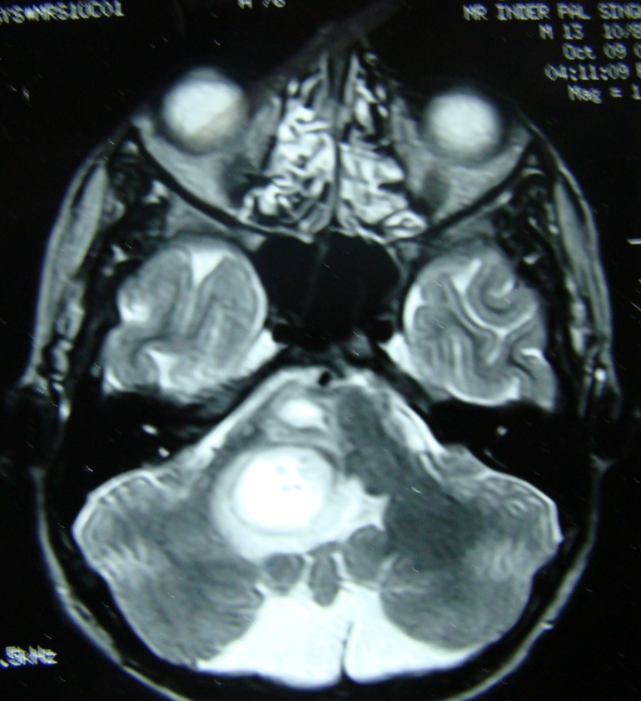
Imaging
MRI-
  Diffuse BSG-
    Hypo on T1, hyper on T2, with hyperintensity extending into adjacent midbrain/medulla, inhomogenous contrast enhancement within or around the tumour
    Contrast enhancement in only 1/3rd cases
    No significant difference in prognosis with/without contrast enhancement

Slide 19
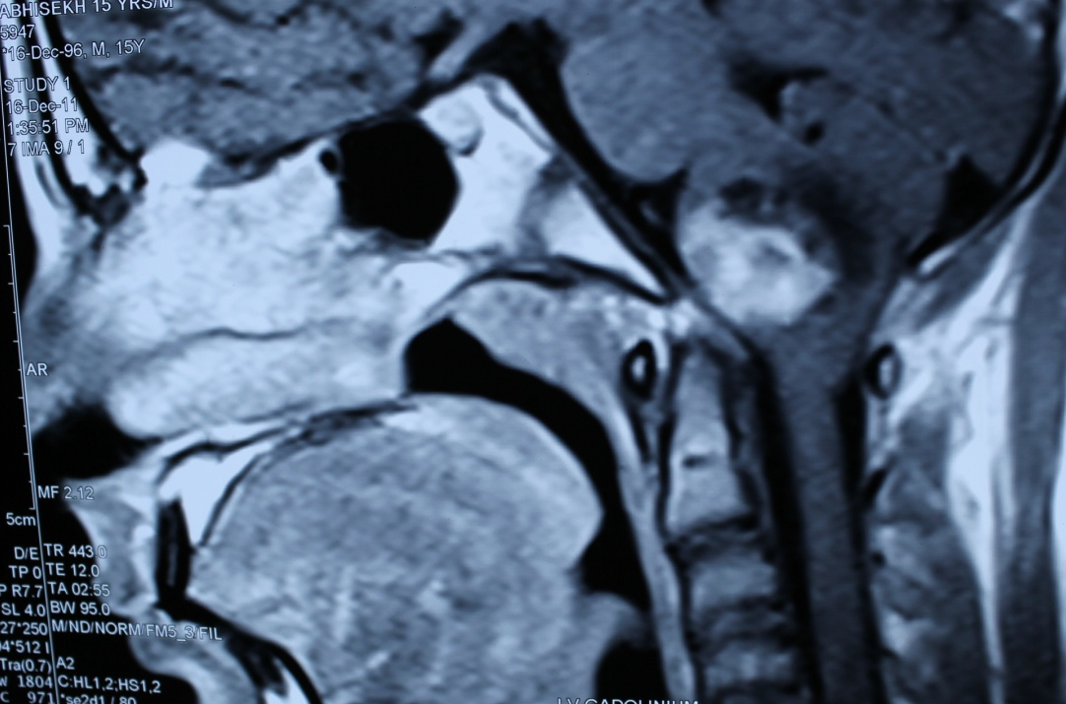
Imaging
MRI-
  Focal BSG-
    Well circumscribed,of limited size, may be partially cystic, without associated oedema/infiltration
    Midbrain >Medulla>Pons
    Hypo on T1, hyper on T2, nidus of focal enhancement
    Usually pilocytic astrocytomas

Slide 20
Imaging
MRI-
  Dorsally exophytic BSG-
    Intra-IVth ventricular
    Resemble vermian astrocytoma with involvement of IVth ventricular floor

Slide 21
Practical decisions regarding treatment of BSG
MRI brain
Diffuse lesion,
(Usually pontine, high grade,
clinically aggressive)
Lesion not diffuse on MRI
No need of biopsy
Steroids, CSF diversion if needed
Regardless of location,
have a significant probability
of being low grade
DIRECT RT+CT

Slide 22
Practical decisions regarding treatment of BSG
Lesion not diffuse on MRI
Cervico-
medullary
Focal midbrain,
Tectal plate
Focal
medullary
Cystic
Dorsally exophytic
Usually low grade,
Astrocytoma &
ganglioglioma
ETV ± Biopsy
Upto 50% low
grade
astrocytoma
Usually
pilocytic astrocytoma
Usually low grade,
astrocytoma
Surgery may
be considered
weighing the risks
Cyst decompression
With radical excision
of nodule
Surgical excision
flush with IV th
ventricular floor
Radical surgery
Periodic followup

Slide 23
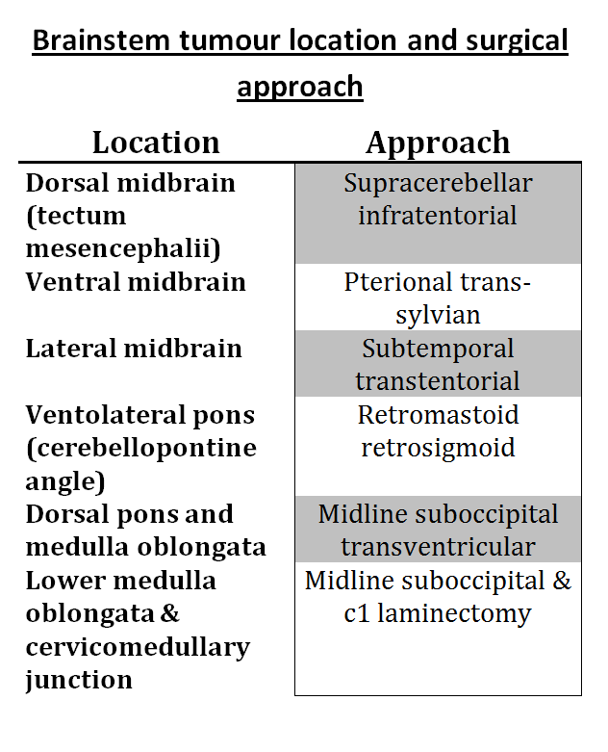

Slide 24
Intraoperative monitoring
Cranial nerves-
    EMG monitoring – III,IV,V,VI,VII, IX,X,XI,XII
    BAEP
SSEP and MEP

Slide 25
Anaesthesia for brainstem surgery
Multimodal monitoring – SpO2 & EtCO₂ monitoring, CVP line, arterial line, trans-esophageal echocardiography,
etc.

Slide 26
Anaesthesia for brainstem surgery
During brain stem surgery, traction of cranial nerves and stimulation of nuclei and connecting pathways may cause severe alterations in blood pressure and heart rate, sudden respiratory drive despite the surgical level of anesthesia.
Extreme bradycardia and ventricular arrhythmia can be life-threatening and must be treated promptly by immediate interruption of surgical stimulation before any pharmacological intervention

Slide 27
Surgical technique-
Almost all BSTs are dorsally located, therefore should be approached through posterior fossa
Position-prone(preferred)/sitting
Midline skin incision
Suboccipital craniotomy±cervical laminotomy
Y –shaped dural opening

Slide 28
Surgical technique-
Vermis coagulated and split at appropriate level
Cerebellum held to the sides using self- retaining retractors( * avoid excessive side retraction – pseudobulbar palsy )
IVth ventricle approached after division of medullary velum

Slide 29
Surgical technique-
Pontine - bulge in IVth ventricular floor
Medullary- medulla will be ballooned
Midbrain - precentral cerebellar vein and arachnoid over vein of galen complex may need to be divided

Slide 30
Safe entry zones to brainstem - Rationale
The brain stem is densely composed of important neural structures such as nuclei and neural tracts
Causes of morbidity following brainstem surgery-
  Direct damage during removal of the lesion,
  Selection of an entry route into the brain stem, and
  The direction of brain stem retraction
In most cases, the optimal surgical route can be established by use of the 2-point method, in which an imaginary line drawn from the center of the lesion to the point nearest the surface of the brain defines the least disruptive approach
Where critical neural structures are sparse and no perforating arteries are present.

Slide 31
Safe entry zones to brainstem
Suprafacial triangle-
  MLF medially,
  VII nerve caudally
  SCP & ICP laterally
The brain stem can be retracted either laterally or rostrally with relative safety
Kyoshima K,Kobayashi S et al.A study of safe entry zones via the floor of the fourth ventricle for brain-stem lesions.
Report of three cases. JNS 1993

Slide 32
Safe entry zones to brainstem
Infrafacial triangle
  MLF medially,
  Striae medullares caudally,
  Facial nerve laterally
The brain stem can be retracted only laterally

Slide 33
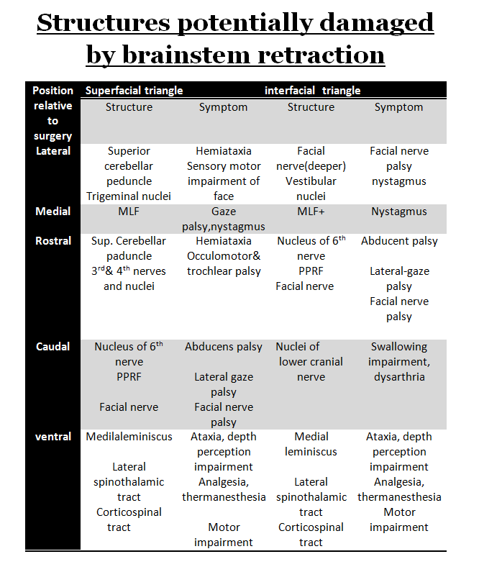

Slide 34
Safe entry zones to brainstem- Anterolateral aspect
Midbrain- lateral mesencephalic sulcus
Pons- peritrigeminal area
Medulla- retro-olivary sulcus
Recalde R.
MICROSURGICAL ANATOMY OF THE SAFE ENTRY
ZONES ON THE ANTEROLATERAL BRAINSTEM
RELATED TO SURGICAL APPROACHES TO
CAVERNOUS MALFORMATIONS.
Neurosurgery, 2008.

Slide 35
Tumour decompression
Conventional suction technique frequently causes brainstem dysfunction manifested by bradycardia & arrhythmia
CUSA causes movement of adjacent structures only within 1mm of vibrating tip, allowing for extensive and quick dissection adjacent to or within the substance of brainstem

Slide 36
Surgical technique-
Focal tumour
Essential that rostral & caudal pole of the tumor be completely exposed
Incise the lower vermis to obtain adequate separation of tonsils to view the entire posterior surface of IVth ventricle
Important to view the median raphe, calamus scriptorius and the obex

Slide 37
Surgical technique-
Focal tumour
Incision at an area where tumor is most superficial
It also must be away from the midline and at least 1.5cm rostral to the obex- avoids injury to cranial nerve nuclei X-XII
Incision <1cm

Slide 38
Surgical technique-
Focal tumour
Use of plated bayonet(very small plates at the tip) as ‘microretractor’
CUSA at a low setting
Careful identification of white matter interface
Minimal manipulation of adjacent normal tissue

Slide 39
Surgical technique- Cervicomedullary tumour
Suboccipital craniotomy + osteoplastic laminotomy
Expose both rostral and caudal extent of the tumor.
USG guidance to know extent of tumor prior to opening the dura - entire tumor should be within the confines of the operative exposure

Slide 40
Surgical technique- Cervicomedullary tumour
The rostral end of a benign cervicomedullary tumor invariably expands posteriorly at the obex
Tumor is,in fact, displacing the medulla rostrally rather than extending into it.
This explains why these tumor present with cervical myelopathy rather than LCN dysfunction
Conceptually, these tumor should be regarded as ‘ intramedullary spinal cord tumours’

Slide 41
Surgical technique- Cervicomedullary tumour
Midline myelotomy
    ‘True’ midline to be identified
    Identify DREZ bilaterally
If tm is solid-cystic, myelotomy to be palced first at tumor-cyst junction→cyst removed prior to tumor excision.
If tumor is non-cystic, myelotomy where tumor is most voluminous & closest to the pial surface.

Slide 42
Surgical technique- Cervicomedullary tumour
Myelotomy to be terminated 1 cm proximal to the caudal pole of the tumor→tumor is least voluminous here, removed by gradual upward dissection
At the rostral pole,tumor invariably subpial and bulging posteriorly at the obex

Slide 43
Surgical technique- Cervicomedullary tumour
USG to guide the extent of tumor excision- to confirm bulk of tumour is removed
Don’t chase small questionable fragments
If deterioration of SSEP/MEP during the procedure, interrupt the dissection and move to another area

Slide 44
Surgical technique-
Cystic tumour
Bulge into the IVth ventricle
“Collapse” of the cyst cavity and surrounding neural tissue following cyst evacuation → difficulty in identifying the solid nodule
‘Hand-held’ retractor compared to fixed
Avoid frequent manipulation of retractor
Use of LASER

Slide 45
Surgical technique-
Dorsally exophytic tumour
Mostly benign, arising from subependymal tissue and grow posteriorly in the area of ‘least resistance’-through the floor of IVth ventricle
Major technical complication-injury to neural structures immediately below the ependymal lining

Slide 46
Surgical technique-
Dorsally exophytic tumour
Remove tumor “flush” with the floor of IVth ventricle.
Do not pursue tumour inside the brainstem.
Low grade astrocytoma, ganglioglioma.
Facial colliculus injury.

Slide 47
Complication avoidance & management–
Cervicomedullary tumour surgery
Complication | Avoidance | Management
Kyphoscoliosis | Osteoplastic laminotomy Conservative extent of bone removal based upon USG guidance | Correction & fusion( late post-op)
Sensory (posterior column) deficit | -True midline myelotomy SSEP Initiation of myelotomy at the most bulky portion of the tumor using USG guidance Myelotomy to end 1 cm short of tapering caudal end of the tumor | Physiotherapy, Rehabilitataion

Slide 48
Complication avoidance & management –
Cervicomedullary tumour surgery
Complication | Avoidance | Management
Motor deficit | Avoid chasing small questionable fragments in ventrolateral aspect of the resection cavity USG guidance MEP | Physiotherapy Proper nursing Rehabilitataion
Cardiovascular instability | Close anaesthetic monitoring and prompt discontinuation of manuever

Slide 49
Complication avoidance & management –
Focal BSG surgery
Complication | Avoidance | Management
Cr nv V palsy | - Careful inspection of IVth ventricular floor to detect area of greatest bulge/tumour erosion to be used as entry into the tumour | Corneal lubrication, Tarsorrhaphy
VI,VII | -Careful inspection of erosion site - Localize median raphe and incise away from midline - Safe entry zone landmarks | Corneal lubrication, Tarsorrhaphy, Corrective surgery for LR palsy
VIII | BAER | Hearing aid

Slide 50
Complication avoidance & management –
Focal BSG surgery
Complication | Avoidance | Management
IX-XII palsy | - Identify obex and incise floor 1.5 cm rostral to it if no ependymal erosion is present | Prolonged ventilation and tracheostomy
Cr nv palsies | Ependymal incision < 1cm Use of plated bayonet Stay within the tumour, inspect carefully for the interface
Post-op hypoventilation, hypercarbia & brainstem hypoxia |  | Persistent mechanical ventilation, slow weaning, tracheostomy

Slide 51
Complication avoidance & management –
Cystic BSG surgery
Complication | Avoidance | Management
Retraction injury | Avoid excessive retractor manipulation Hand-held reatactor Laser Avoid CUSA Don’t chase questionable fragments

Slide 52
Complication avoidance & management –
Dorsally exophytic BSG surgery
Complication | Avoidance | Management
Brainstem nuclei injury in general | Good visualization of ependyma above and below the tumour Avoid resection below the ependymal floor | -

Slide 53
Peri-operative care
Perioperative steroids( methylprednisolone)
Elective ventilation for at least 48 hours
Mechanical ventilation till recovery of ventilation & normal cough reflex
LCN paresis- NG/feeding gastrostomy
V,VII nv paresis- temporary tarsorrhaphy
Good nursing care
Physiotherapy
Post-op brainstem injury mostly reversible if surgical technique is proper

Slide 54
Role of stereotactic biopsy
Diffuse glioma is an infiltrative, highly aggressive lesion which is always malignant regardless of the histology at the time of biopsy, associated with a very poor prognosis, MR appearance is reliable → No role of biopsy for these lesions (Epstein,McCleary,1986)
No role of open surgery/stereotactic biopsy in diffuse tumor because of typical MRI characteristics and clinical presentation ( Isamat, 1999)
Risks of biopsy far outweigh the remote possibility of diagnosing something other than a glioma

Slide 55
Role of stereotactic biopsy
Majority of focal, dorsally exophytic and cervicomedullary BSG are benign and resectable by direct surgery with low morbidity and good outcome
New york symposium on Brainstem surgery, 1996.
Epstein, Constantini ,Hoffman, A Bricolo

Slide 56
Role of stereotactic biopsy
Reserved to
    When the diagnosis is uncertain, to rule out inflammatory pathology like TB
    Focal intrinsic endophytic lesion- well limited masses within the brainstem surrounded by neural tissue and therefore do not reach the surface

Slide 57
Role of GKRS
Yen CP, Sheehan J, Steiner M, Patterson G, Steiner L.
Gamma knife surgery for focal brainstem gliomas.
J Neurosurg. 2007 Jan;106(1):8-17.
20 patients
10-18 Gy
Median follow up- 78 months
Tm disappeared in 4 pts, decreased in size in 12 pts
Minimal peri & post- procedural morbidity

Slide 58
Take home message
BSG are a heterogenous group of neoplasm
Importance of MRI in diagnosis and planning of treatment
Minimize complications by operating upon ‘benign’ lesions in the presence of minimal neurological dysfunction
Knowledge of ‘safe entry zones’

Slide 59
Take home message
Diffuse tumor almost invariably malignant and should not be operated upon→ Direct RT + CT
Focal medullary tumor
    Likely to be benign
    Surgery associated with significant morbidity
    If laterally located & appears to be approachable with acceptable risks, resection is appropriate. If more centrally located→ Stereotactic biopsy + Irradiation
    Role of primary radical excision still unclear

Slide 60
Take home message
Dorsally exophytic tumor-
    Likely to be benign
    Radical excision
    Do not enter brainstem
Cervicomedullary tumor-
    Likely to be benign
    Radical excision
Cystic tumor –
    Radical excision
Focal pontine tumor-
    Radical excision if tm is close to the surface

Slide 61
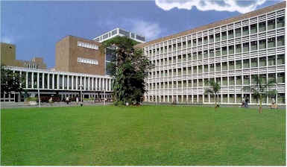
Thank you

